Slide 1

Text Complexity and Readability Analysis
Meeting # 4

Slide 2
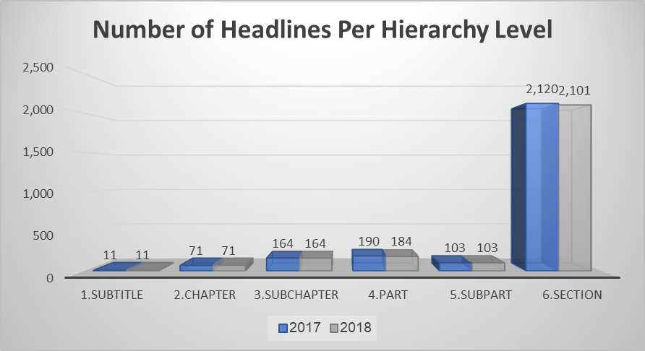
Data collection and processing
There is a significant similarity in the structure of the headlines of the tax codes between the years 2017 and 2018

Slide 3
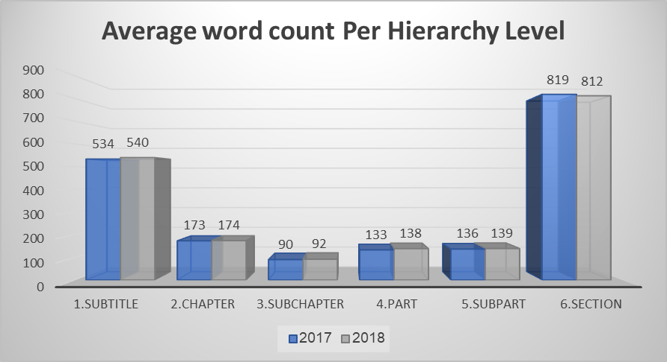
Data collection and processing
Additionally, considering the amount of words at each level of hierarchy/headlines, there is a significant similarity of the tax codes between the years 2017 and 2018

Slide 4
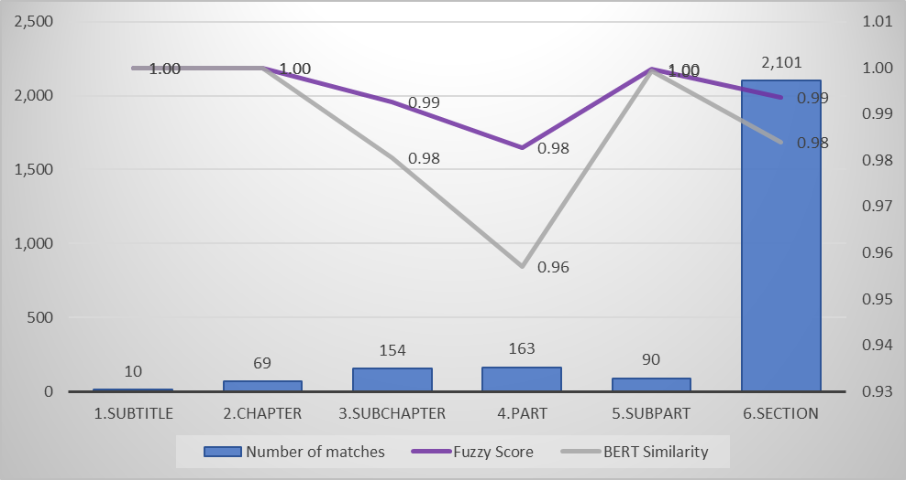
Headlines Analysis - Matched Results
Matched
2,587 | Total Matched Headlines
 | (Unique matched)
Cosine Similarity - Matched Headlines
2,587 | count
0.819 | mean
0.222 | std
0.147 | min
0.557 | 0.25
1.000 | 0.5
1.000 | 0.75
1.000 | max
Examining textual similarity scores (Fuzzy Score) and semantic similarity (BERT Similarity) for headlines between the years 2017 and 2018, it can be observed that most headlines exhibit significantly high similarity.
Fuzzywuzzy - Compares words in titles between 2017 and 2018 based on textual similarity (word order, letters, structure). It uses the Levenshtein Distance algorithm to measure how similar two strings are (counts how many changes: insertions, deletions, or substitutions). Returns a similarity percentage (0-100) between two texts.
Threshold - Titles are considered similar when both textual similarity and semantic similarity are above 80%.

Slide 5
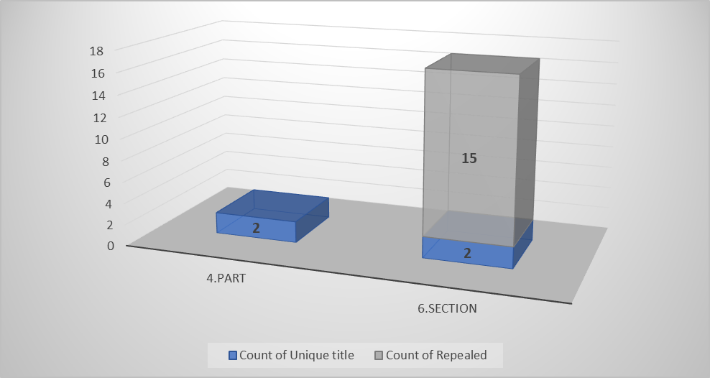
Headlines Analysis - Unmatched Results
Matched\Unmatched Results
2,587 | Total Matched Headlines
0 | Unique Headlines - 2017
19 | Unique Headlines - 2018
No unique titles were found in 2017 (considering textual similarity and semantic similarity).
Only 19 unique titles found in 2018. But, 15 of them, are title that have been repealed.
Indicates a high similarity in titles between the years.

Slide 6
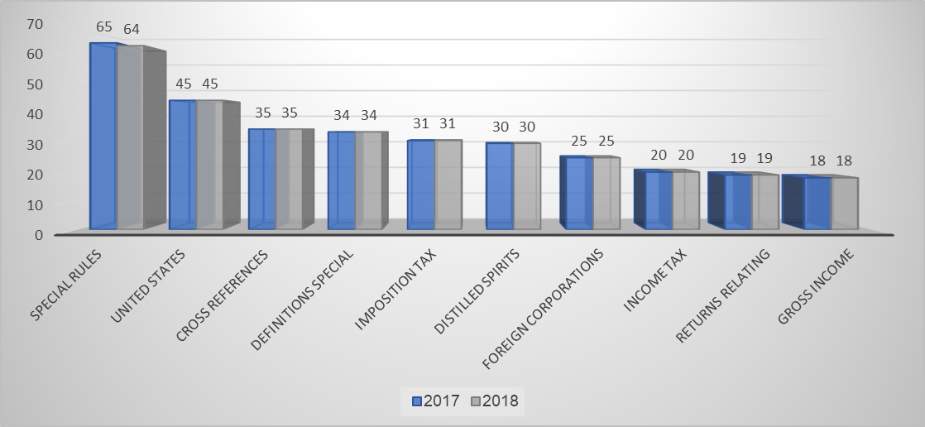
Headlines Analysis - N-Grams
2018 | 2017 | Bigram
64 | 65 | special rules
45 | 45 | United States
35 | 35 | Cross references
34 | 34 | Definitions special
31 | 31 | Imposition tax
30 | 30 | distilled spirits
25 | 25 | foreign corporations
20 | 20 | income tax
19 | 19 | Returns relating
18 | 18 | gross income
16 | 16 | certain foreign
14 | 14 | taxable year
14 | 14 | life insurance
13 | 13 | Rate tax
13 | 13 | payment tax
13 | 13 | gain loss
12 | 12 | Trust Fund
11 | 11 | real property
11 | 11 | Failure file
10 | 10 | taxable income
9 | 11 | tax credit
10 | 10 | tax liability
10 | 10 | provisions relating
10 | 10 | Internal Revenue
10 | 10 | Excise tax
9 | 9 | Tax imposed
9 | 9 | returns documents
Top 10 Headlines
N-Grams is a text analysis technique that breaks sequences of words or characters into groups of N consecutive elements. It is commonly used for tasks such as document similarity analysis. By analyzing patterns in sequences, N-Grams help improve language modeling and information retrieval.
Results indicates a high similarity in titles between the years.

Slide 7
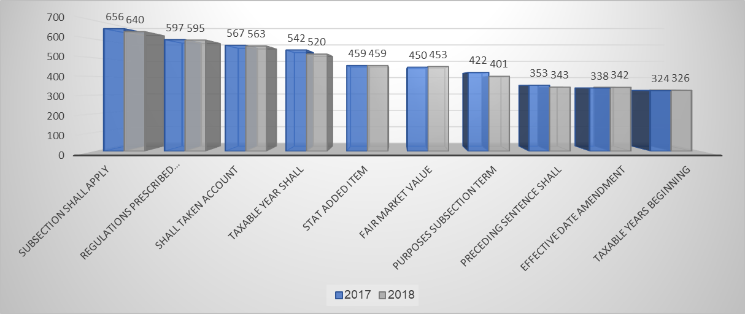
Content Analysis - N-Grams
Top 10 Content
2018 | 2017 | Trigram
640 | 656 | subsection shall apply
595 | 597 | regulations prescribed secretary
563 | 567 | shall taken account
520 | 542 | taxable year shall
459 | 459 | stat added item
453 | 450 | fair market value
401 | 422 | purposes subsection term
343 | 353 | preceding sentence shall
342 | 338 | effective date amendment
326 | 324 | taxable years beginning
326 | 323 | secretary shall prescribe
313 | 313 | income taxable year
303 | 306 | shall apply respect
300 | 306 | meaning given term
Results of N-Grams analysis, considering the content of the titles between the years, also indicates a high similarity in titles between the years.
Identify and detect unique words used in the tax code for the year 2018 – information regarding this issue has not yet been received.

Slide 8
Content Analysis - Textual & Semantic similarity
Cosine similarity matrix is calculated using a Cartesian product (each paragraph compared with every other paragraph)
Not all paragraphs have the same count (for example, 5 paragraphs in 2017 but only 3 in 2018)
The placement of paragraphs may change
The goal is to find the best match – a Cartesian product ensures that every paragraph is compared against every other paragraph to identify the most significant difference
Each value in the matrix represents the degree of similarity between the corresponding paragraph from 2017 and the corresponding paragraph from 2018.
The closer the value is to 1 → the paragraphs are very similar.
The closer the value is to 0 → the paragraphs are very different.

Slide 9
Content Analysis - Textual & Semantic similarity
Average Cosine Similarity
Hierarchy level | High | Medium | Low | No Similarity | Total
1.Subtitle | 1.00 | 0.60 |  |  | 0.96
2.Chapter | 1.00 | 0.80 | 0.52 |  | 0.96
3.Subchapter | 1.00 | 0.80 | 0.37 | 0.24 | 0.97
4.Part | 1.00 | 0.82 | 0.47 |  | 0.95
5.Subpart | 1.00 | 0.79 | 0.55 |  | 0.96
6.Section | 0.99 | 0.78 | 0.50 | 0.24 | 0.79
Total | 0.99 | 0.79 | 0.50 | 0.24 | 0.82
Average Min Similarity
Cosine Similarity Category | High | Medium | Low | No Similarity | Total
High | 1.00 | 0.84 |  |  | 0.99
Medium |  | 0.71 | 0.48 | 0.12 | 0.59
Low |  |  | 0.40 | -0.01 | 0.00
No Similarity |  |  |  | 0.01 | 0.01
Total | 1.00 | 0.74 | 0.48 | -0.01 | 0.65
High similarity in most hierarchy levels, except in Sections level
Considering minimum similarity for each Cosine Similarity Category, that may indicate changes in content - there is relative consistency in the results

Slide 10
Content Analysis - Textual & Semantic similarity
Average Cosine Similarity
Hierarchy level | High | Medium | Low | No Similarity | Total
1.Subtitle | 1.00 | 0.60 |  |  | 0.96
2.Chapter | 1.00 | 0.80 | 0.52 |  | 0.96
3.Subchapter | 1.00 | 0.80 | 0.37 | 0.24 | 0.97
4.Part | 1.00 | 0.82 | 0.47 |  | 0.95
5.Subpart | 1.00 | 0.79 | 0.55 |  | 0.96
6.Section | 0.99 | 0.78 | 0.50 | 0.24 | 0.79
Total | 0.99 | 0.79 | 0.50 | 0.24 | 0.82
Average Min Similarity
Cosine Similarity Category | High | Medium | Low | No Similarity | Total
High | 1.00 | 0.84 |  |  | 0.99
Medium |  | 0.71 | 0.48 | 0.12 | 0.59
Low |  |  | 0.40 | -0.01 | 0.00
No Similarity |  |  |  | 0.01 | 0.01
Total | 1.00 | 0.74 | 0.48 | -0.01 | 0.65
High similarity in most hierarchy levels, except in Sections level
Considering minimum similarity for each Cosine Similarity Category, that may indicate changes in content - there is relative consistency in the results

Slide 11
Tasks assignment
# Cat. | # | Category | Task | Assign to | Due date | Status
1 | 1.1 | Data Collection & Preprocessing | Download publicly available versions of the U.S. Tax Code for the years 2017 and 2018 in PDFs | Tomer | 08/12/2024 | DONE
 | 1.2 |  | Develop scripts for data and features extraction from the Tax Codes (2017 + 2018) | Yifat | 22/12/2024 | DONE
 | 1.3 |  | Clean and structure the data into CSV format | Yifat | 01/01/2025 | DONE
 | 1.4 |  | Review and quality control of the extracted data | Tomer | 02/01/2025 | DONE
 | 1.5* |  | Develop new scripts for data and features extraction based on WORD Tax Codes (2017 + 2018) | Yifat | 15/01/2025 | DONE
2 | 2.1 | Project Definition | Writing a full characterization & definition of the project, according to final project design template | Tomer+ Yifat | 01/01/2025 | DONE
3 | 3.1 | Model Building & Integration | Headings and titles analysis - develop scripts to identifying semantic similarity using LaBSE and lexical similarity using Jaccard Score and Levenshtein distance. | Tomer+ Yifat | 22/12/2024 | DONE
 | 3.2 |  | Model and Algorithm extension - comparative analysis to examine similarity (semantic and lyrical) between smaller units of information, in a sample of cases where the titles were found to be similar. | Tomer+ Yifat | 05/01/2025 | DONE

Slide 12
Tasks assignment
# Cat. | # | Category | Task | Assign to | Due date | Status
3 | 3.3 | Model Building & Integration | Examining common words and phrases, between the code before/after the reform - Headlines (using N-Grams) | Revital | (05/01/2025) 17/01/2025 | DONE
 | 3.3* |  | Examining common words and phrases, between the code before/after the reform - Content (using N-Grams) | Revital | (05/01/2025) 17/01/2025 | DONE
 | 3.4 |  | Examining statistical indices of common words/phrases (such as: median, average, etc.), and Visual presentation (Histogram and other relevant graphs) | Revital+ Ori | (05/01/2025) 17/01/2025 | DONE
 | 3.5 |  | Model and Algorithm extension - Expanding semantic similarity and lexical similarity, considering headings | Tomer | 29/01/2025 | IN PROGRESS
 | 3.5* |  | Model and Algoirthm extension - Expanding semantic similarity and lexical similarity, considering content | Revital+Yifat | 29/01/2025 | IN PROGRESS
 | 3.6 | Model Building & Integration | Model and Algorithm extension - analyzing structural analysis | Yifat | 19/01/2025 | DONE
 | 3.7 |  | Compute number of words, number of headings and subsections | Yifat | 29/01/2025 | DONE
 | 3.7* |  | Compute number of paragraphs with similar titles | Yifat | 29/01/2025 | IN PROGRESS
 | 3.8 |  | Develop scripts for hierarchical parsing and cross-referencing | Tomer+ Yifat | 29/01/2025 | TO DO

Slide 13
Tasks assignment
# Cat. | # | Category | Task | Assign to | Due date | Status
4 | 4.1 | Dashboards & Reporting Development | Build initial interactive dashboards for visualization (presented to end users\legal and technical stakeholder) | Ori+ Guy | 29/01/2025 | IN PROGRESS
 | 4.2 |  | Implement customizable reporting features | Ori+ Guy | 29/01/2025 | IN PROGRESS
 | 4.3 |  | Fine-tuning of the dashboards and customizable reporting features according to legal and technical stakeholder's requirements | Tomer+ Yifat | 06/02/2025 | TO DO
5 | * | Project documentation | Headings and titles analysis - develop scripts to identifying semantic similarity using NPL models – word2vec \ FastText | Revital | 29/01/2025 | IN PROGRESS
 | ** |  | Headings and titles analysis - develop scripts to identifying semantic similarity using NPL models – LLaMA 3.2 \ GPT | Ori\Yifat | 29/01/2025 | IN PROGRESS
 | 5.1 |  | Writing a detailed report (10 pages) explaining the project process, decisions made and evaluation | Tomer+Yifat+ Revital+Ori | 05/02/2025 | IN PROGRESS
 | 5.2 |  | Review, quality control and proofreading of the project report | Team | 10/02/2025 | TO DO
 | 5.3 |  | Writing relevant sections in the article intended for publication, addressing the analysis of tax code complexity using NLP models | Tomer+Yifat+ Revital | 27/02/2025 | TO DO
 | 5.4 |  | Review, quality control and proofreading of the article | Team | 01/03/2025 | TO DO
6 | 6.1 | Evaluation and Testing | Validate results and gather feedback from legal and technical stakeholders | Team | Untill 15/03/2025 | TO DO

Slide 14
Tasks assignment - Timeline
Data Collection & Preprocessing
Project Definition
Model Building & Integration
Dashboards & Reporting Development
Project documentation
Evaluation and Testing
December
January
February
March

